Slide 1
ECEN 404:
Active Ankle-
Foot Orthosis (AAFO)
Alfred Boss
Christopher Galik
Tyler Pierce

Slide 2
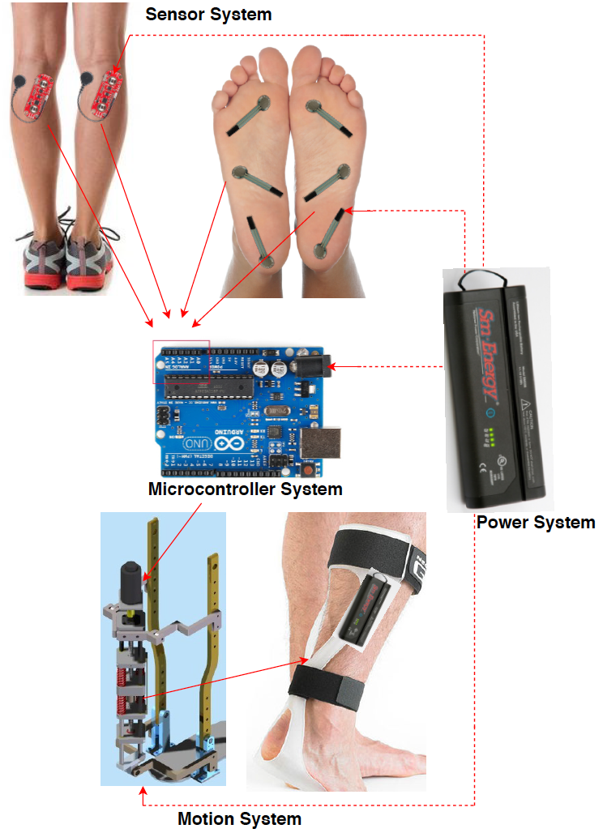
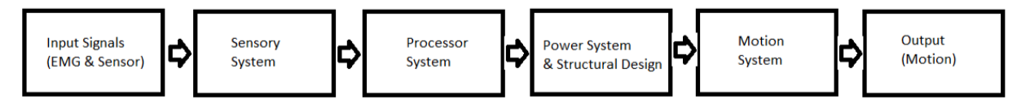
System Overview
EMG sensors and FSR sensors will measure electrical activity and pressure in the leg and foot.
The AAFO will transport signals from the 2 sensors to the MCU.
The microcontroller will interpret signals and determine which stage of gait the user is in and supply corresponding motor control.
The motion system, which acts as an artificial muscle, will move the joint by attaching to a rigid structure.

Slide 3
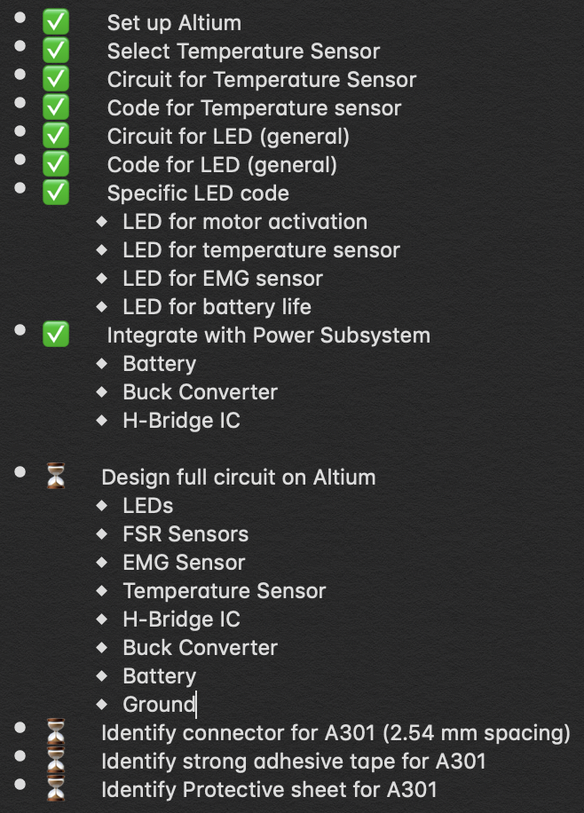
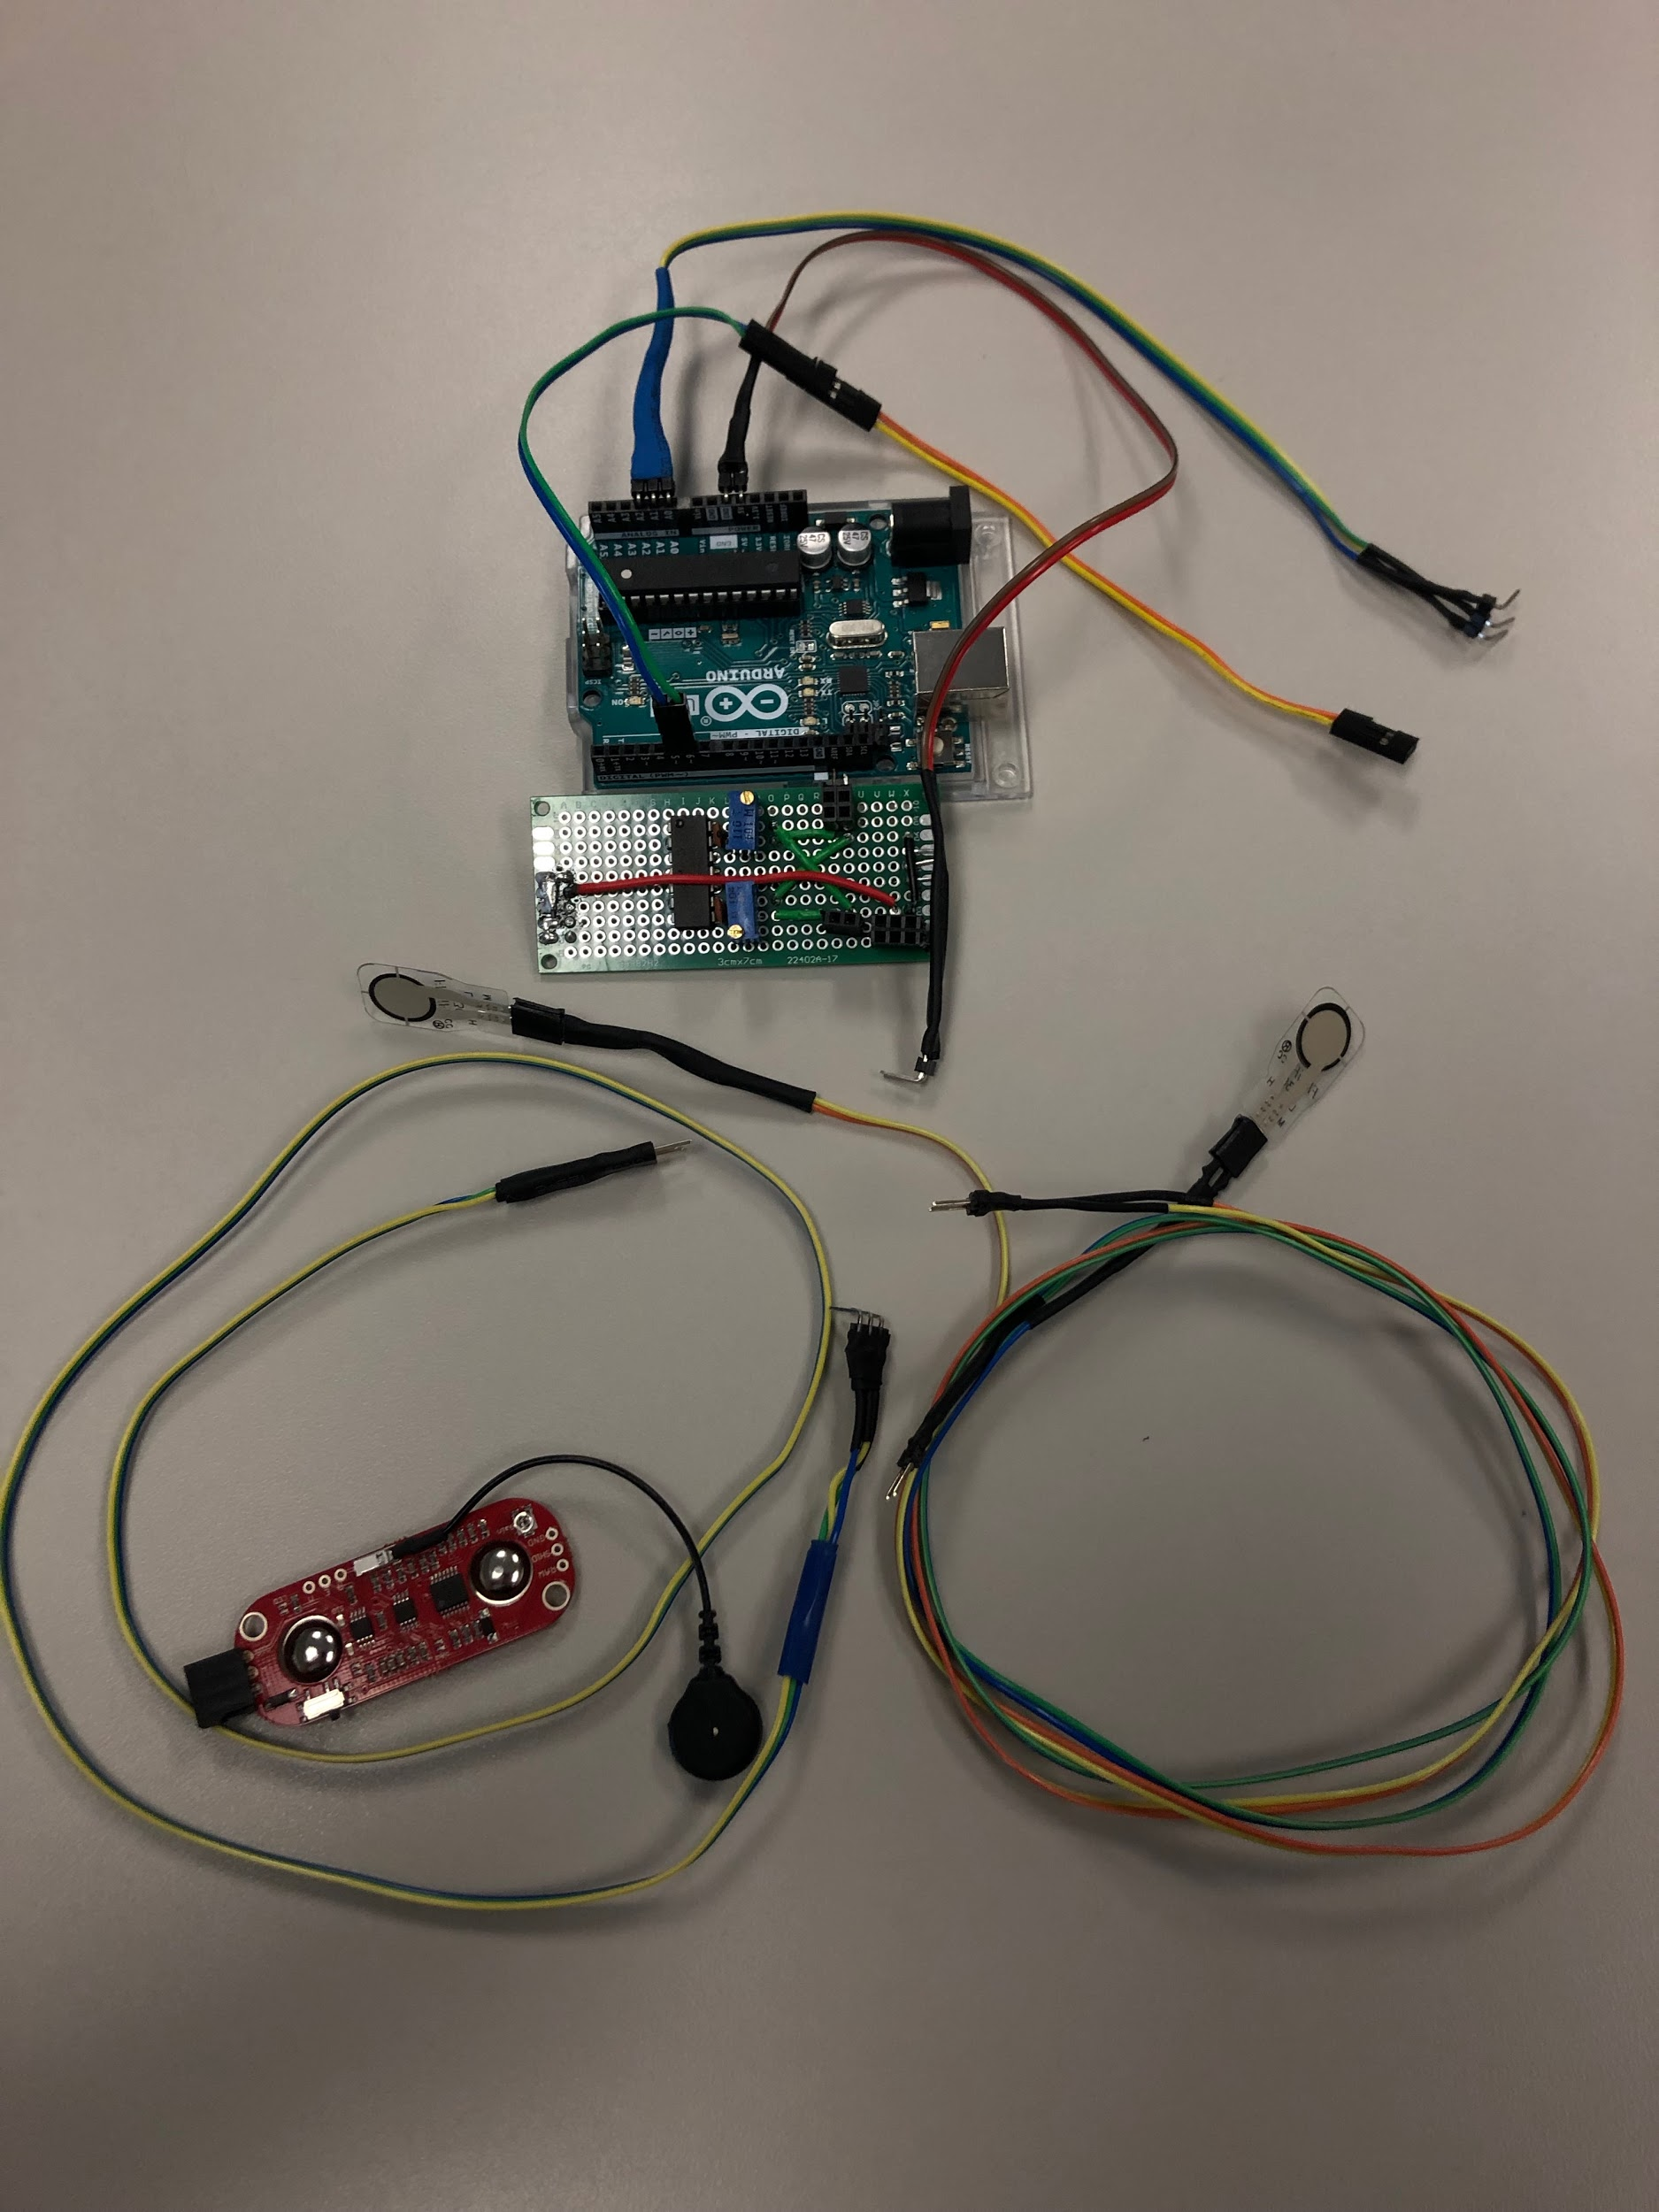
Sensor & MicroController System

Slide 4
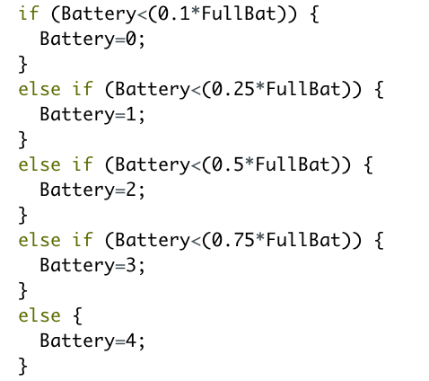

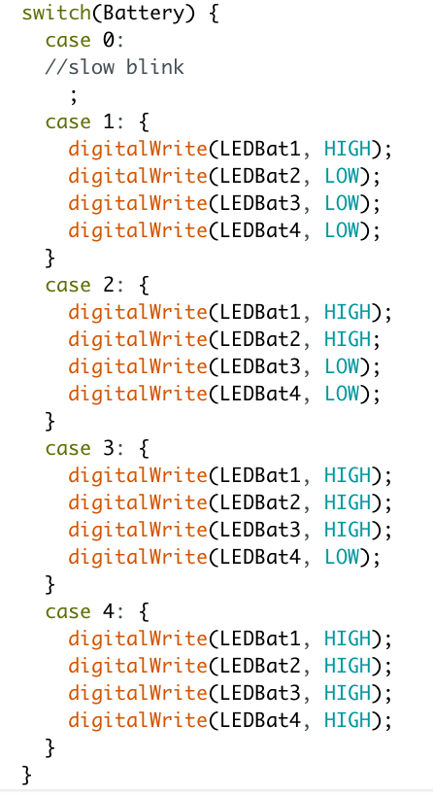
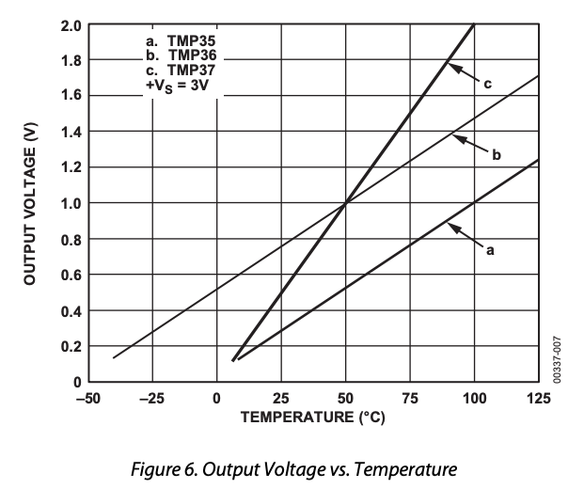
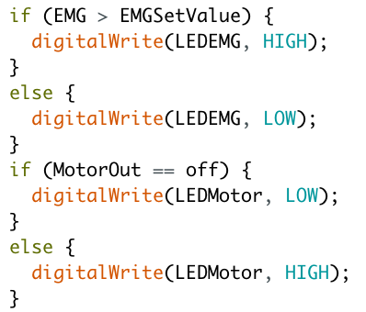
MicroController System Code

Slide 5
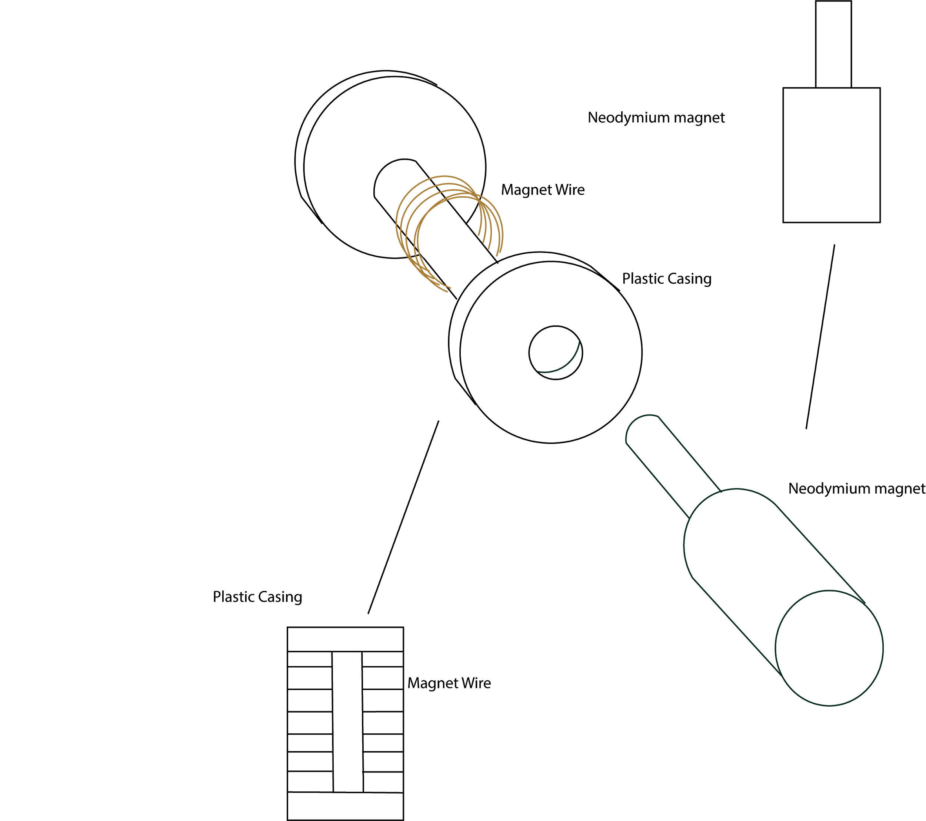
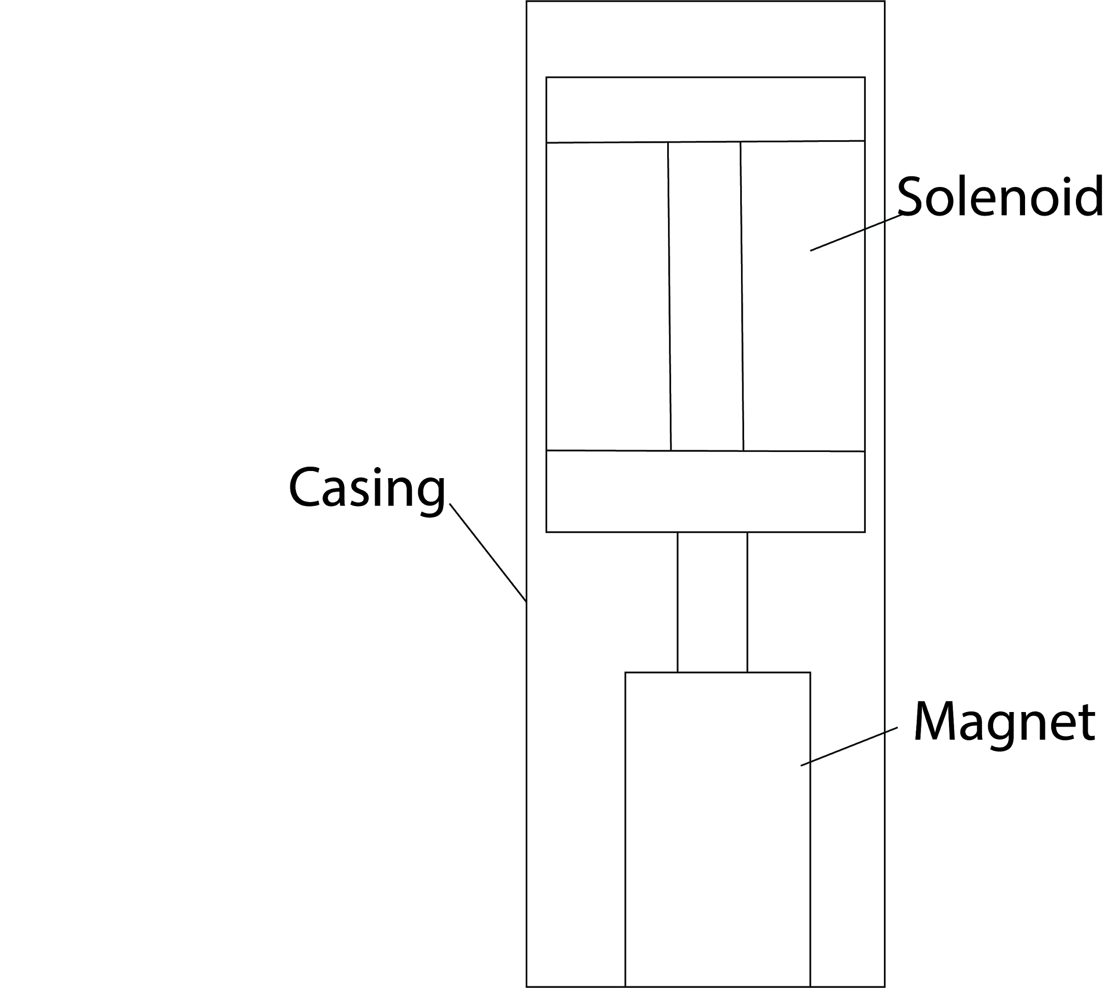
Artificial Muscle/Motion System Development
Bi-Weekly Accomplishments
New fabrication method for solenoid
Ongoing progress/problems
(Another) 3D printing error
Unusable magnet wire

Slide 6
Structural Design
Updates
No updates
Upcoming
Integrate structure with Artificial Muscle and test
Solidworks stress validation

Slide 7
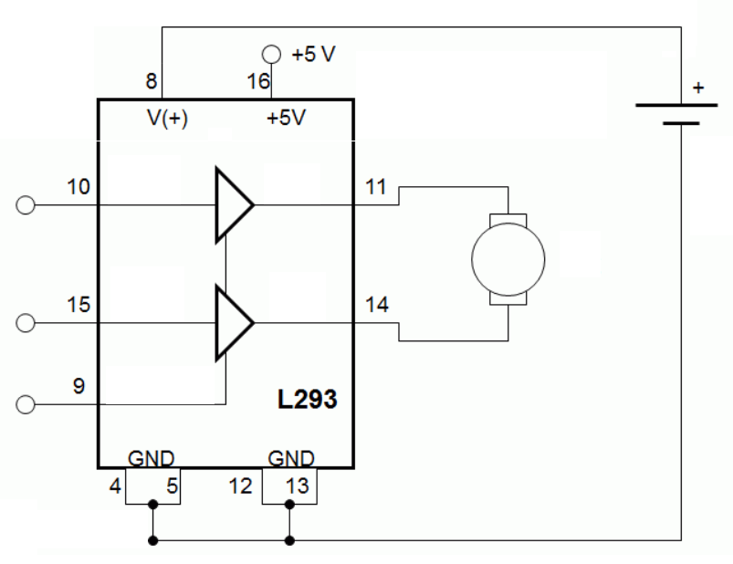
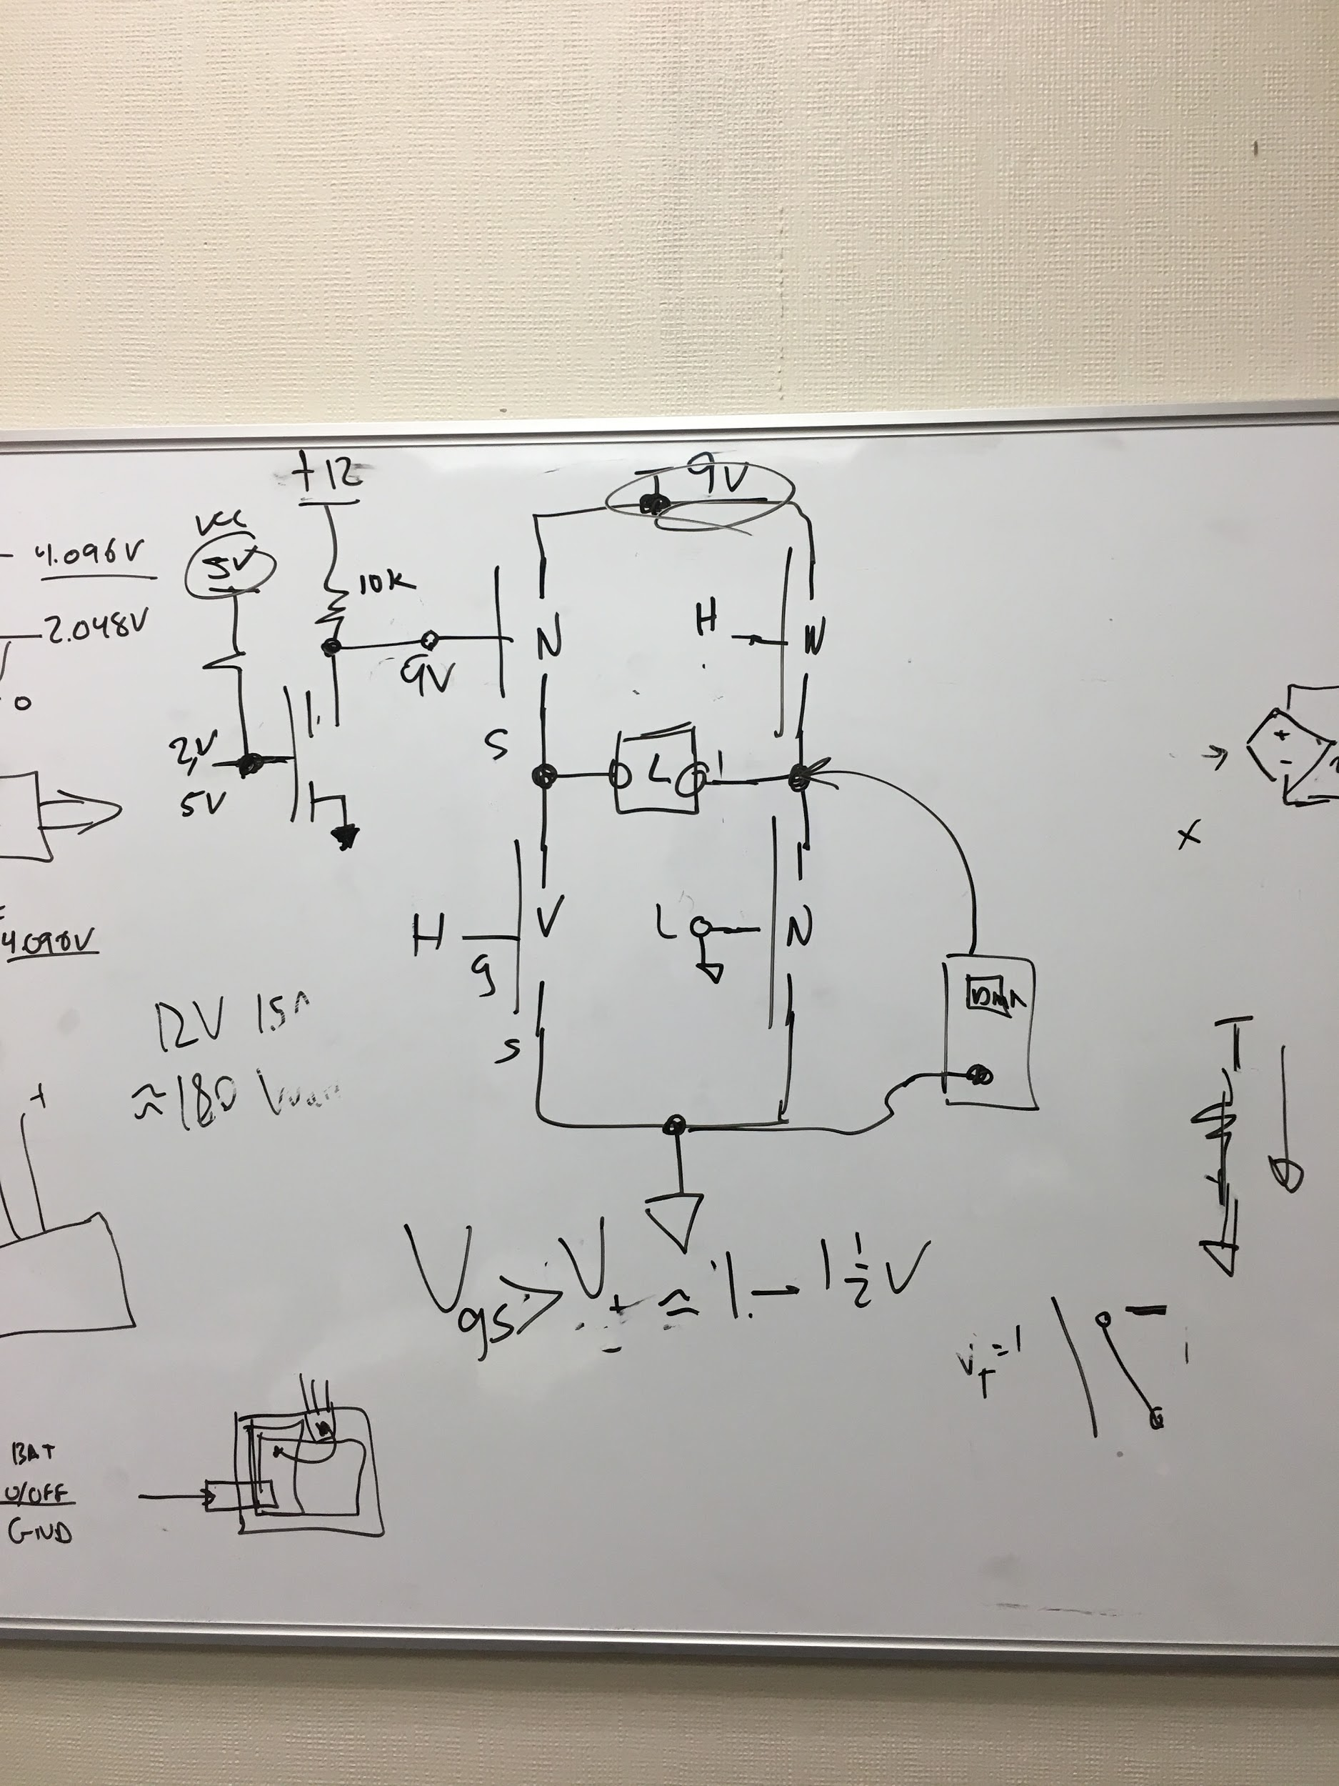
Power System
Updates
Power system validated (Converter & H-bridge) under no load condition
Converter Simulation Completed
Upcoming
Validate with battery (Under load? - Additional switch w/ H-bridge)
Integrate with Artificial Muscle and test

Slide 8
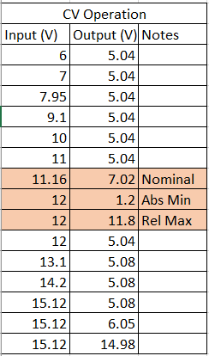
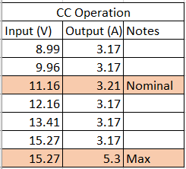
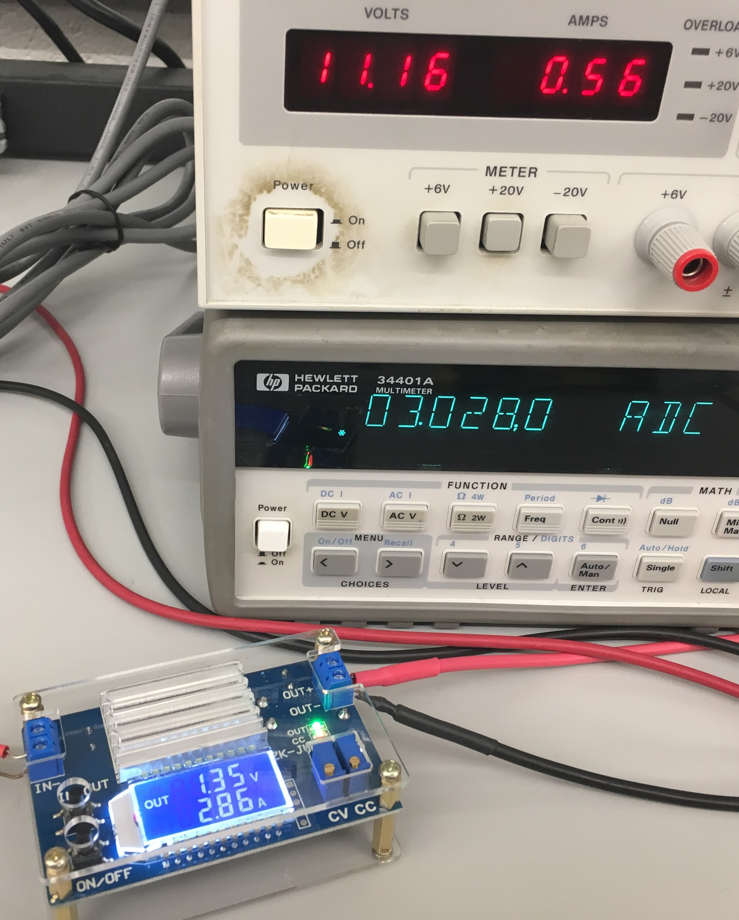
CC/CV Converter w/o Battery

Slide 9
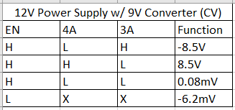
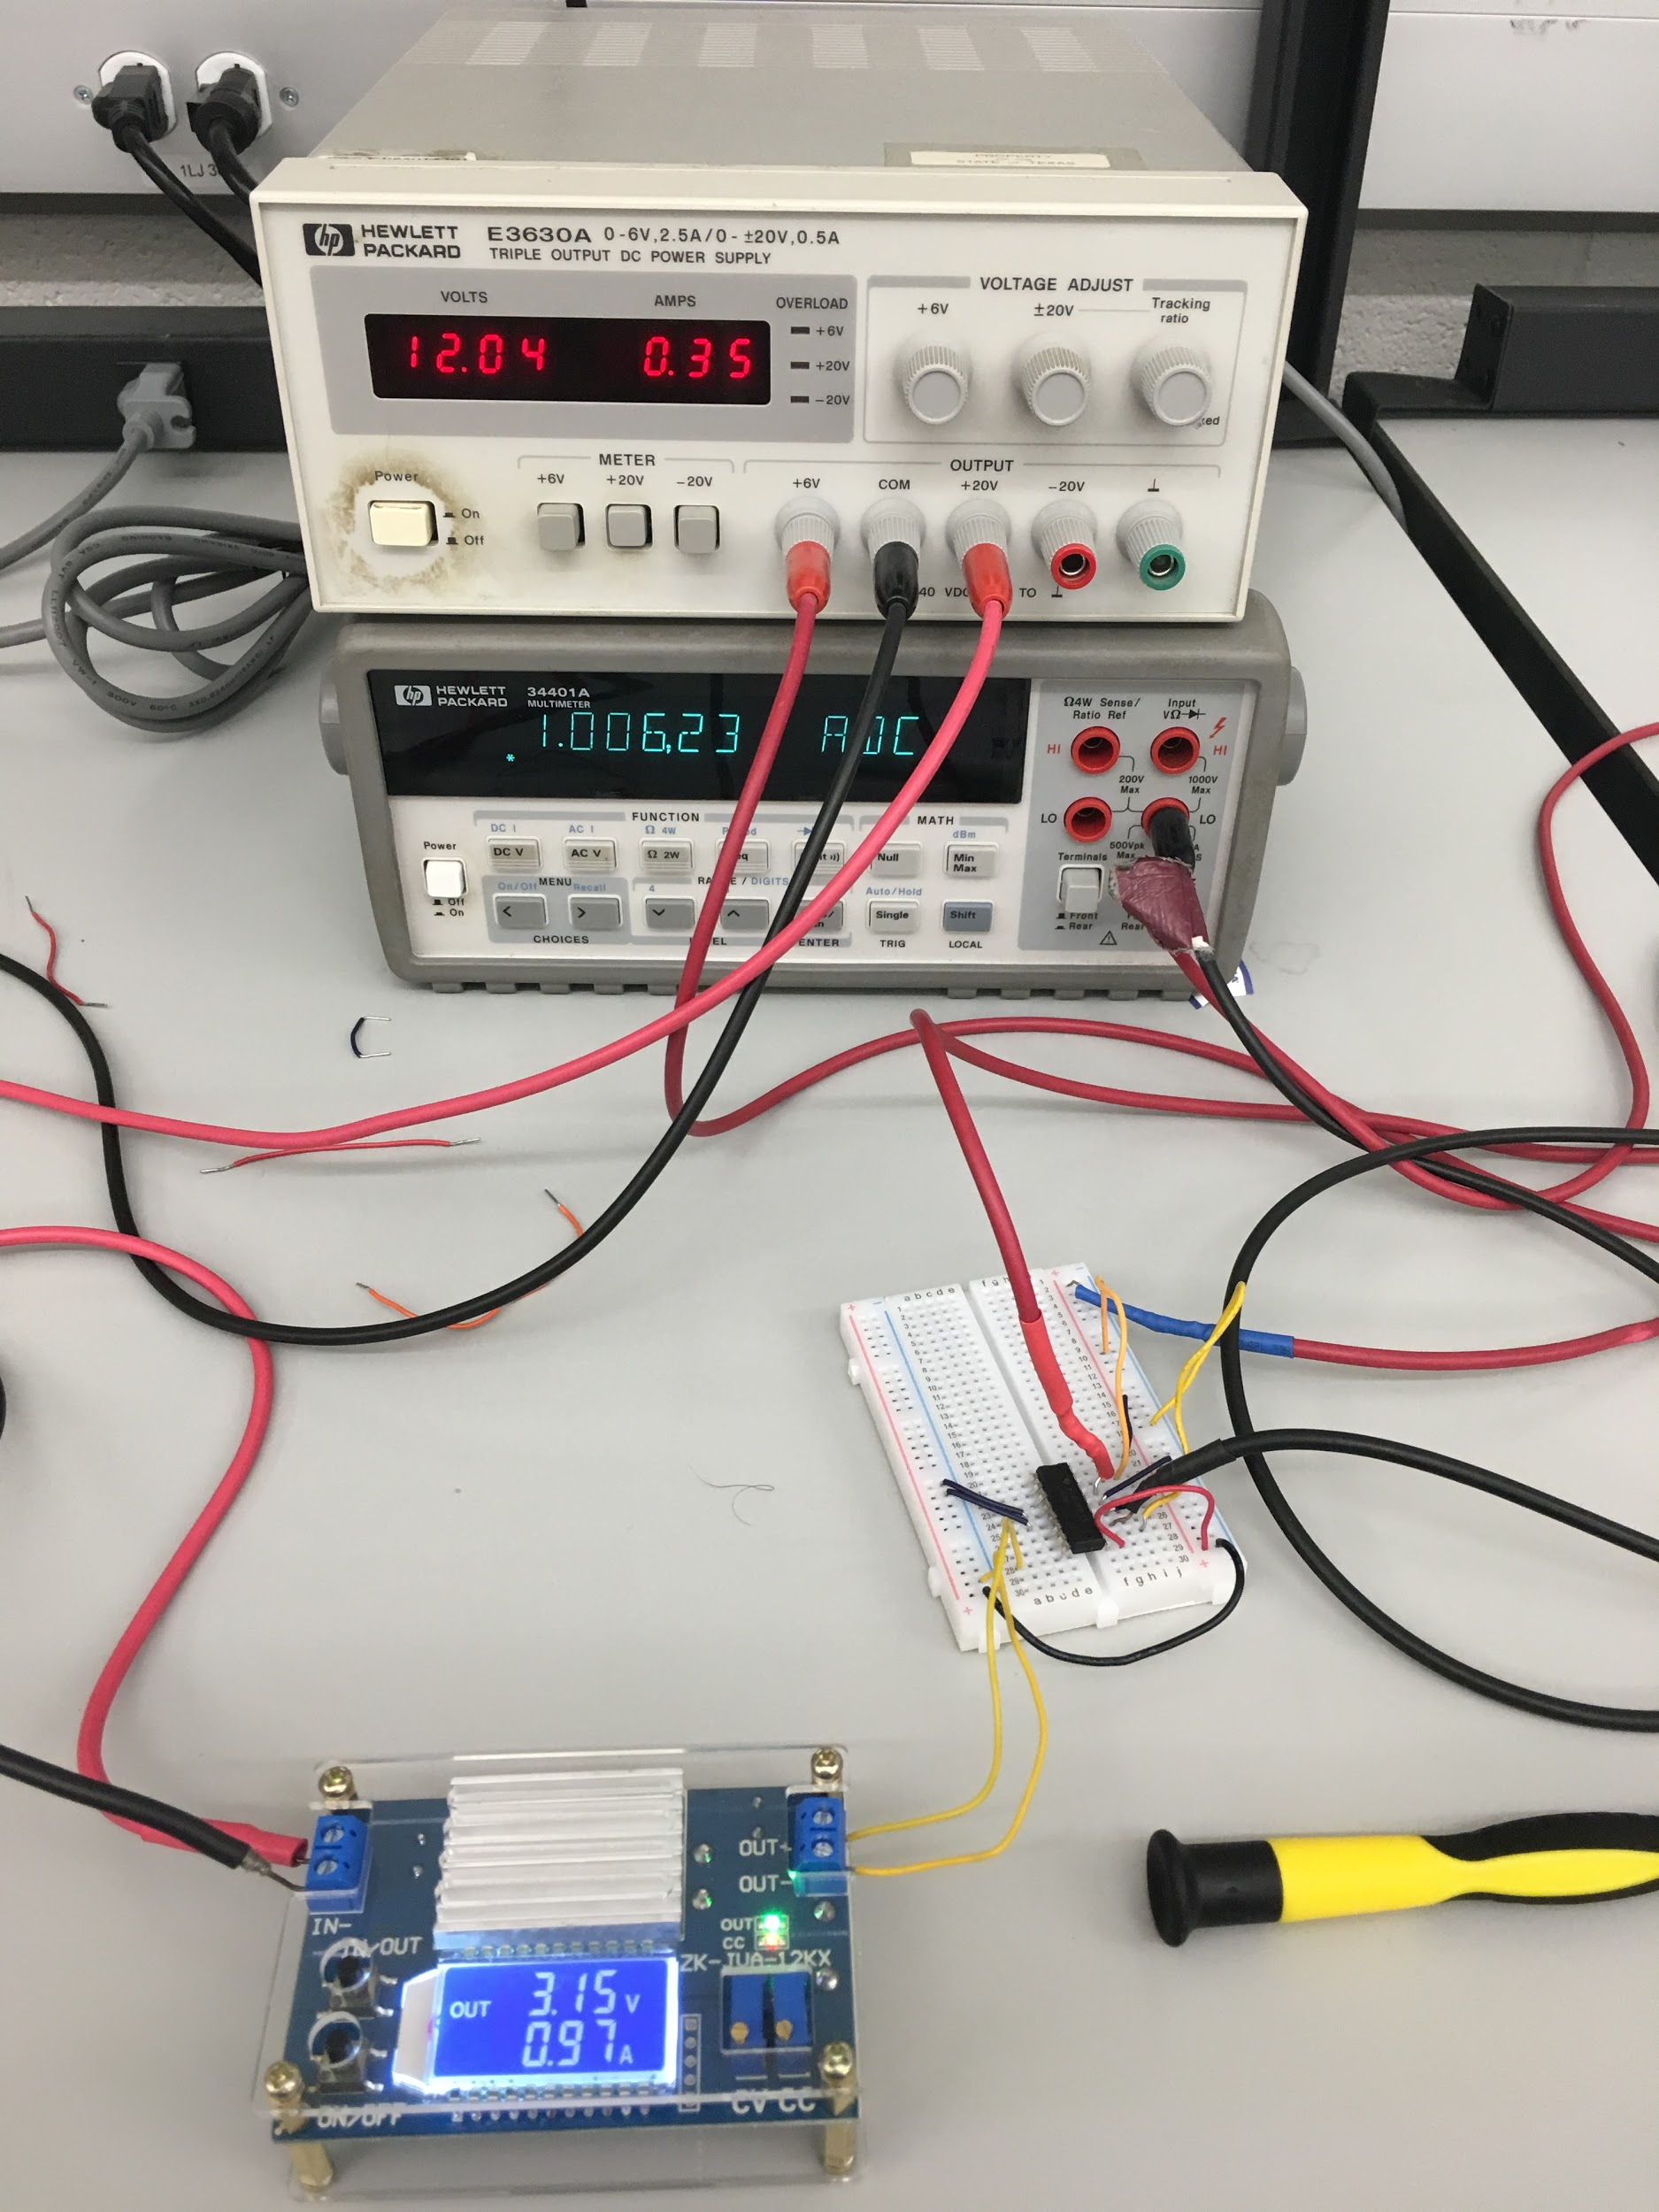
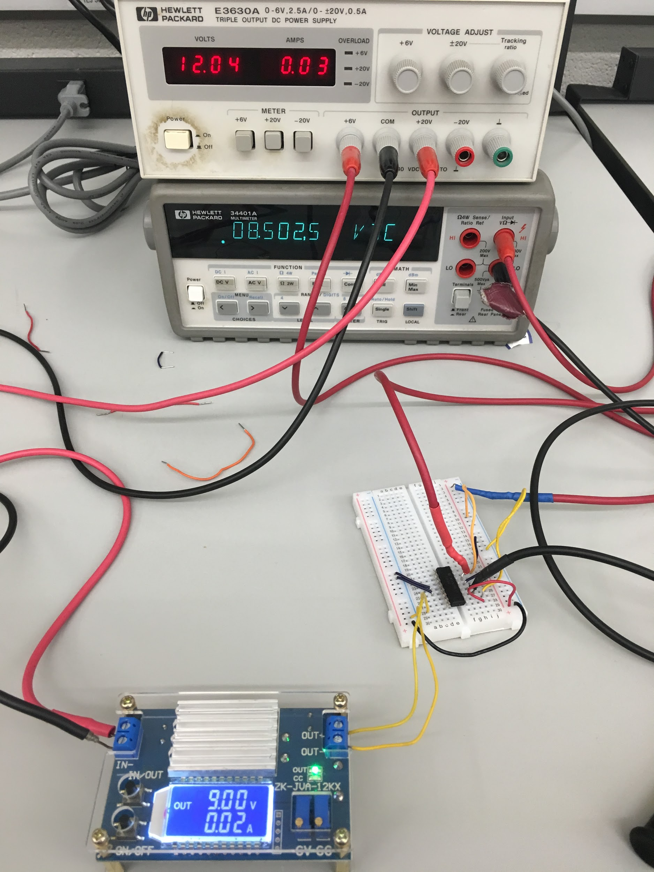
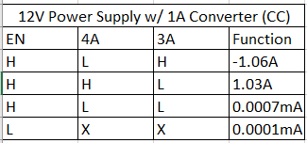
H-bridge (Gates 3&4) w/ Converter w/o Battery

Slide 10
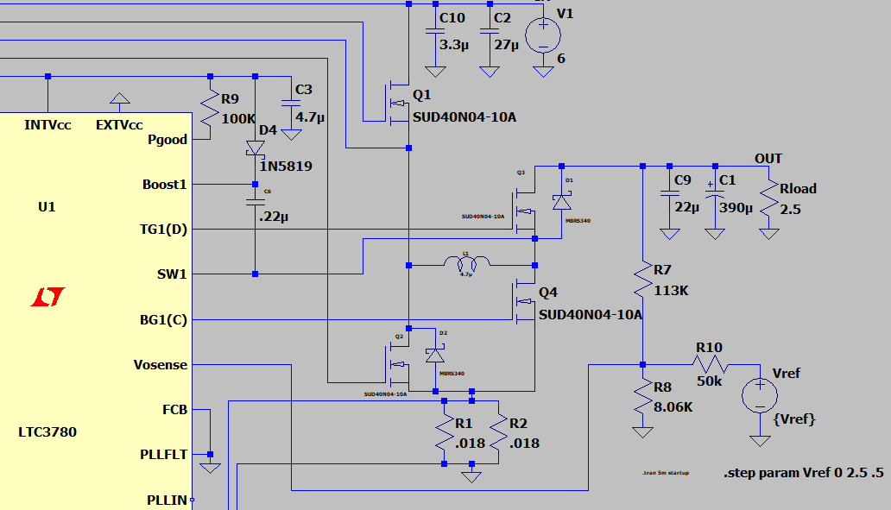
Converter Simulation
Transient simulation
w/ Vref sweep from 0V to 2.5V at 0.5V increments
Feedback reference

Slide 11
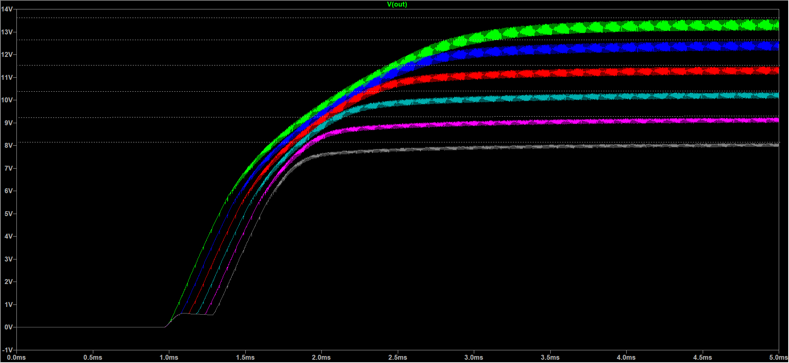
Converter Simulation

Slide 12
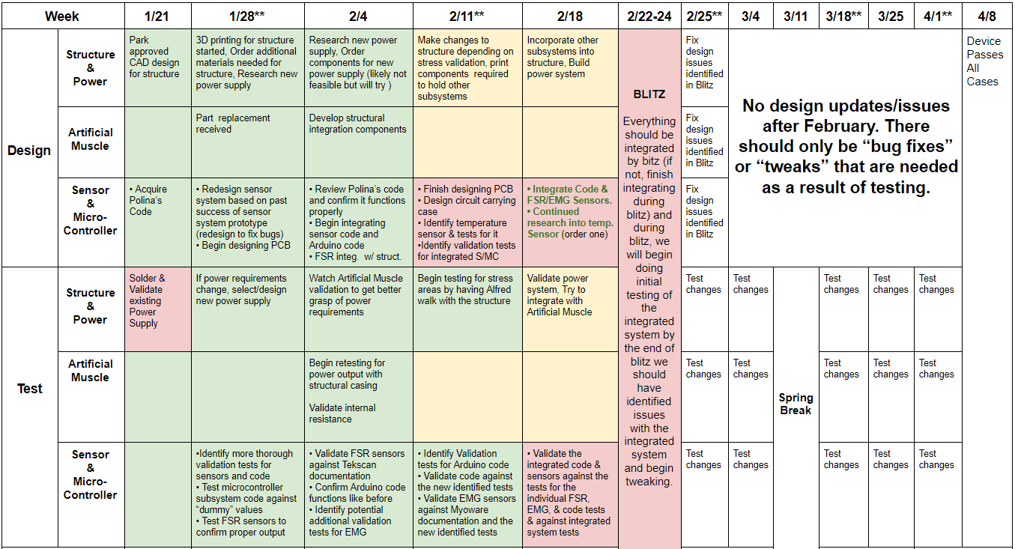
Execution Plan

Slide 13
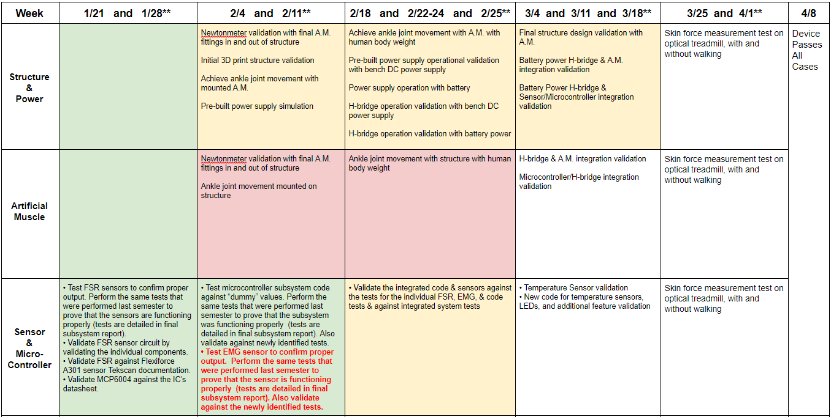
Validation Plan

